Slide 1

PATHFINDER
A modern platform for student’s path

Slide 2
Table of contents
01
02
03
04
Our team
Idea
Process
Used technologies

Slide 3


Idea

Slide 4
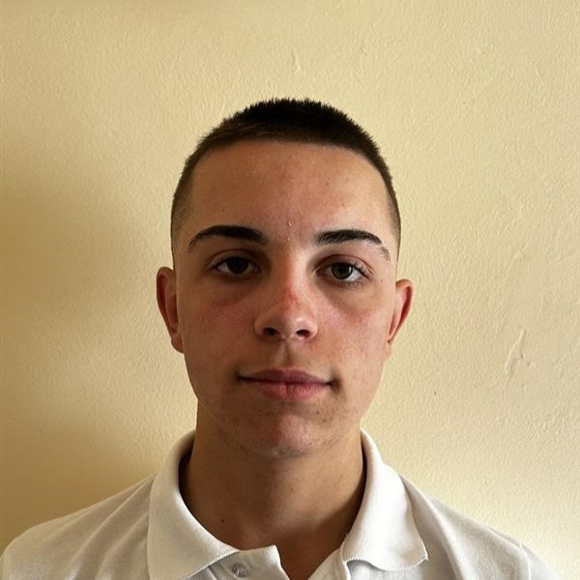
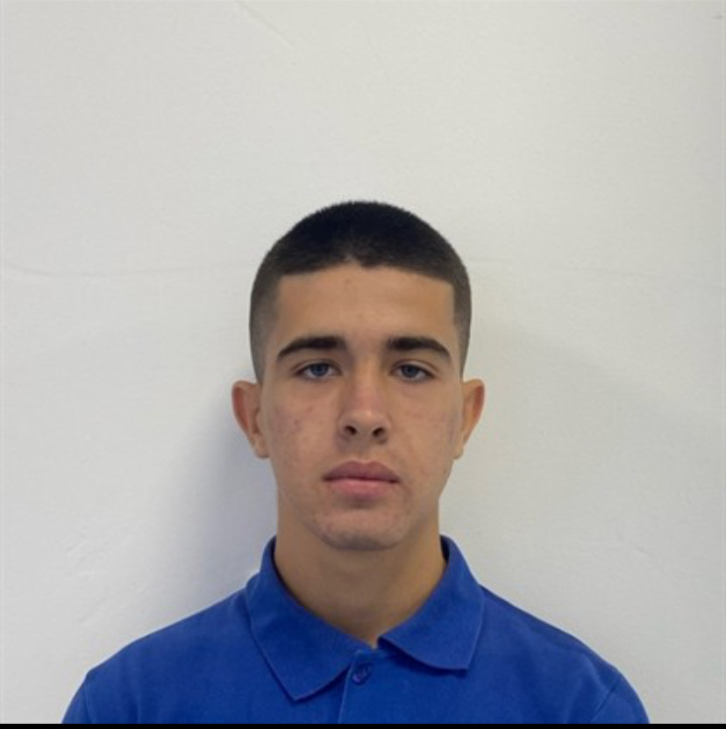
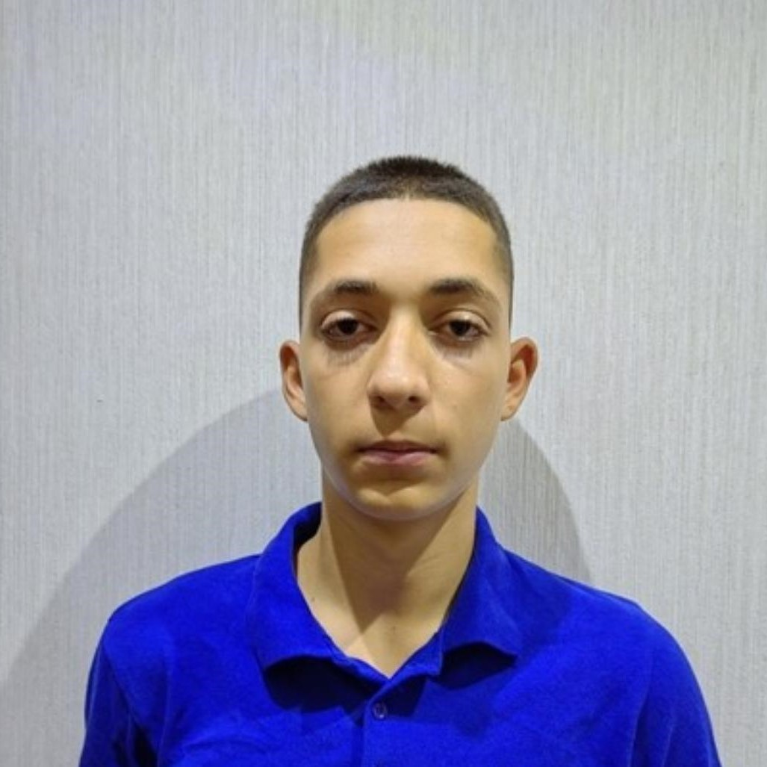


Our team

Slide 5
Process
Organization
Decide on the idea
Development
Present

Slide 6
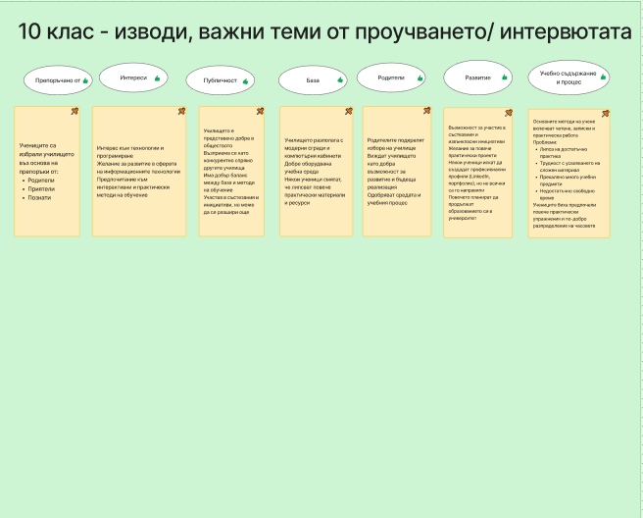
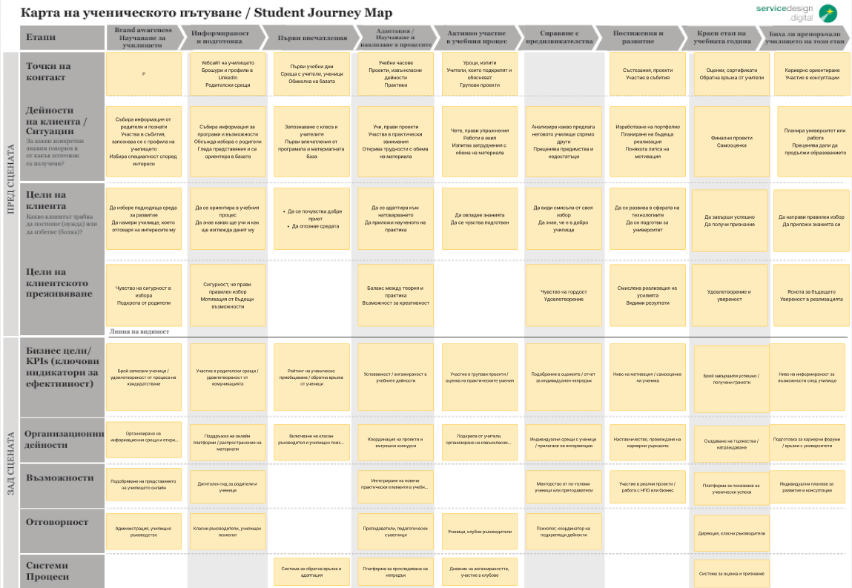
Organization

Slide 7
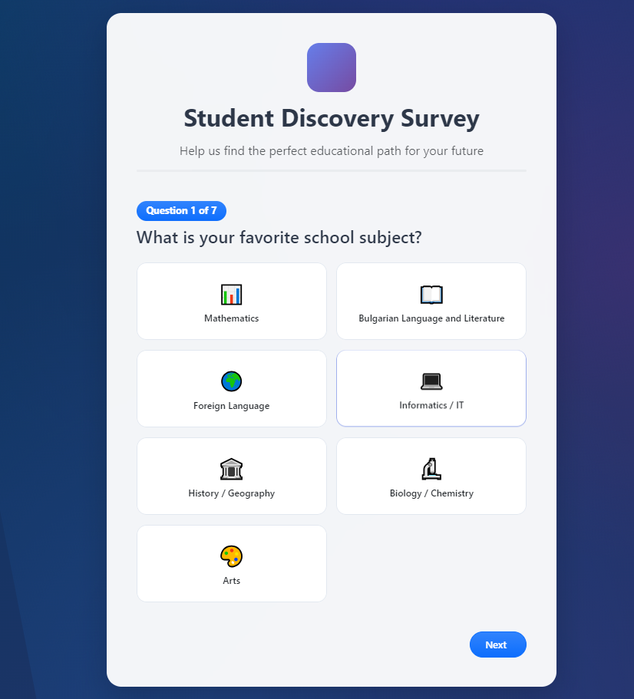
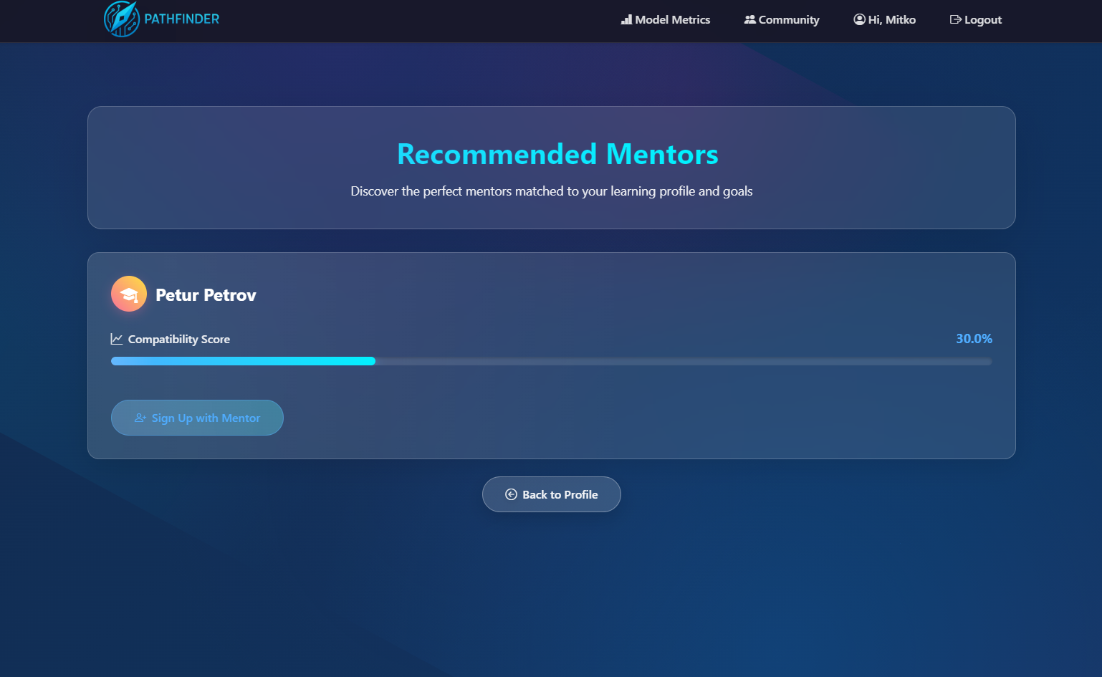
Decide on the idea

Slide 8
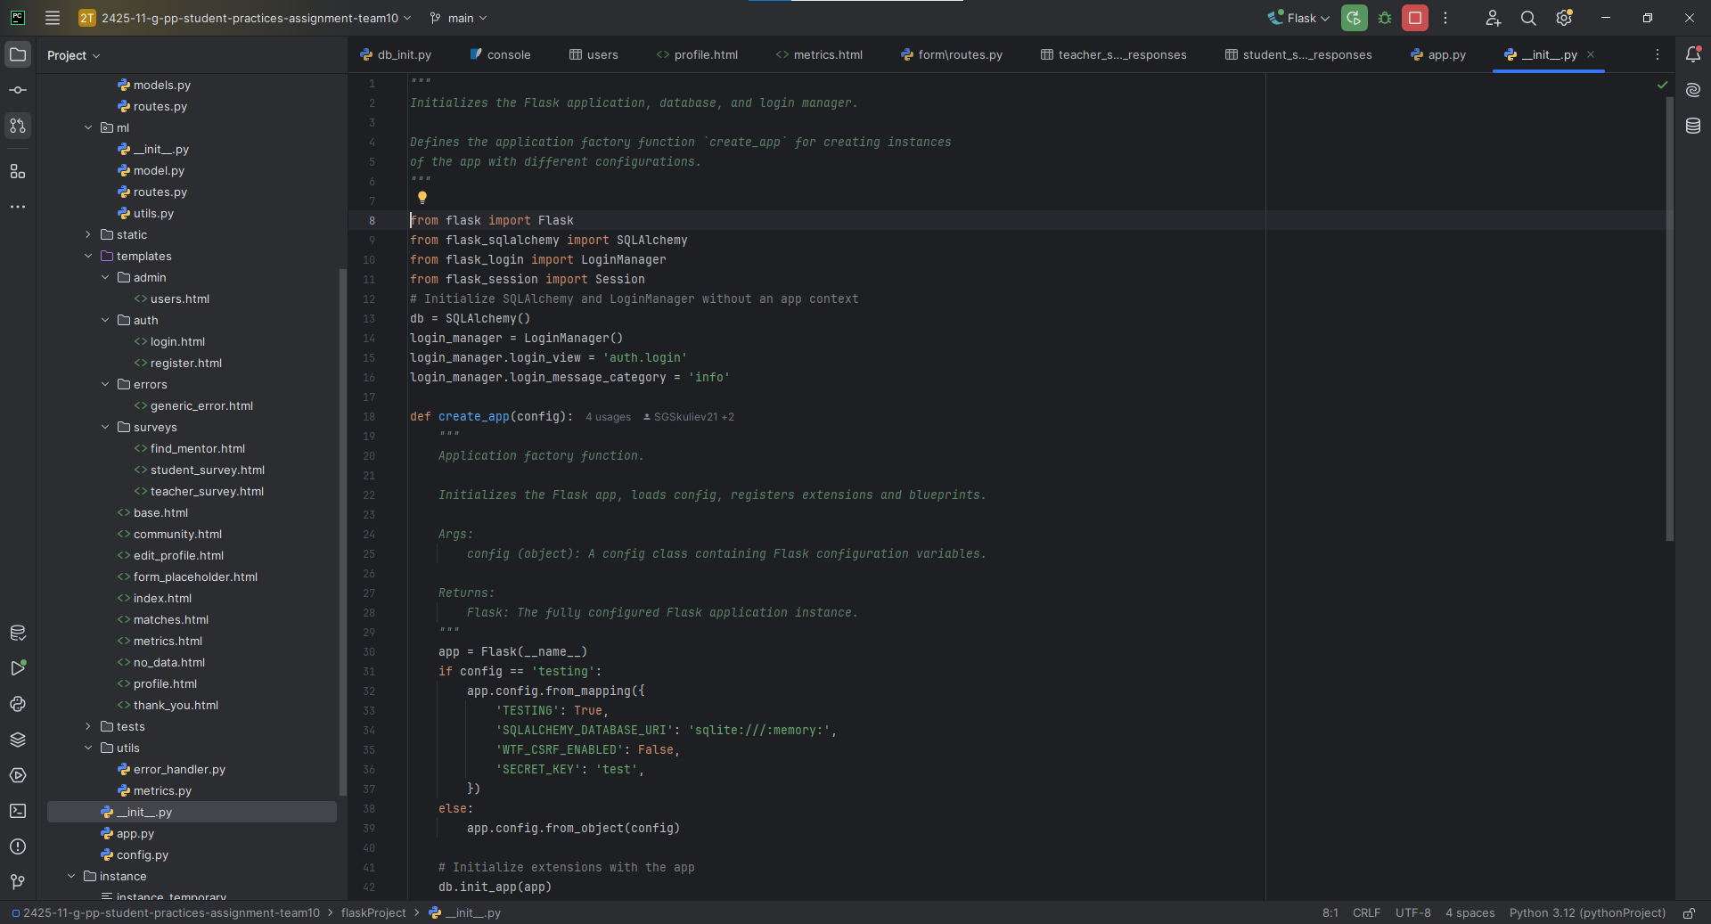
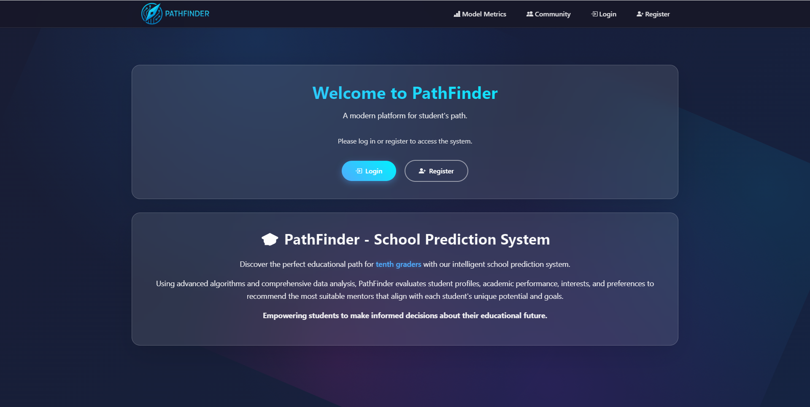
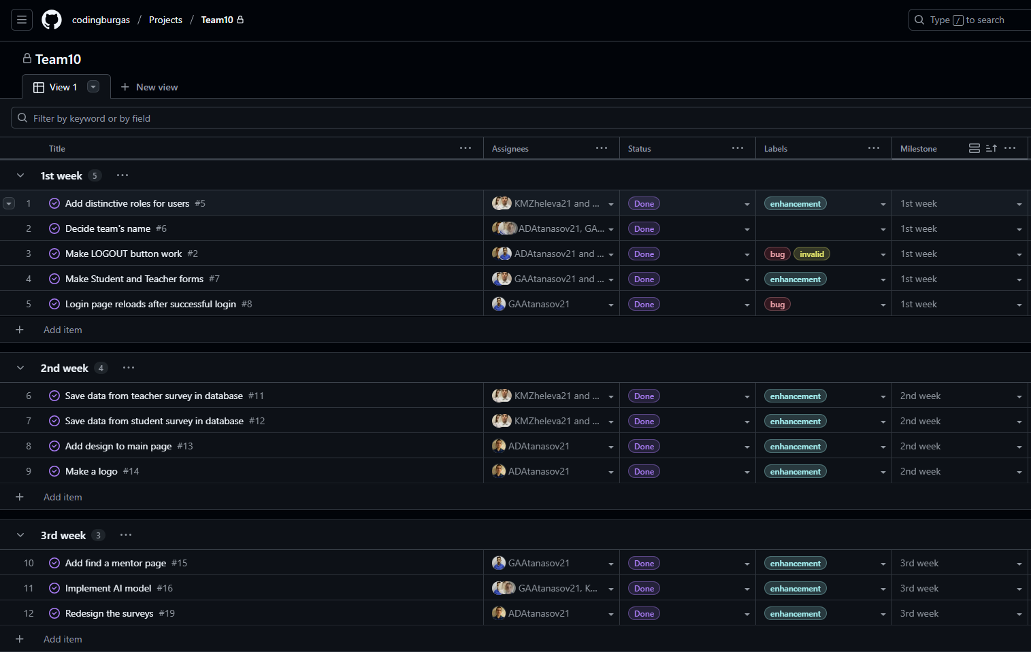
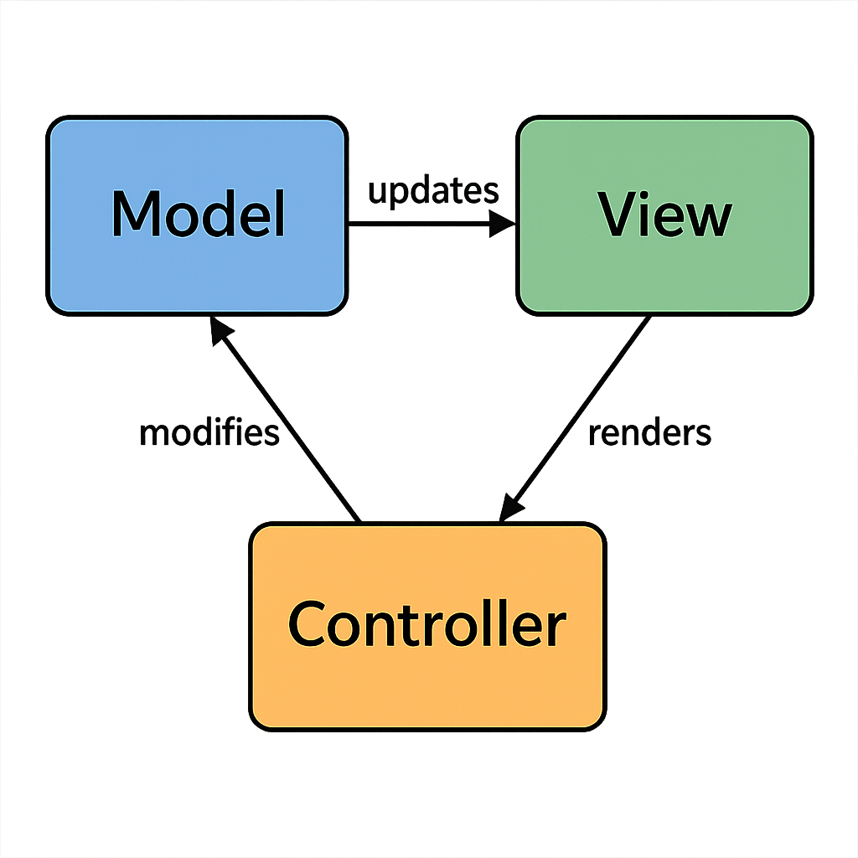
Development

Slide 9








Used technologies for development

Slide 10
Let’s jump into the project

